Slide 1
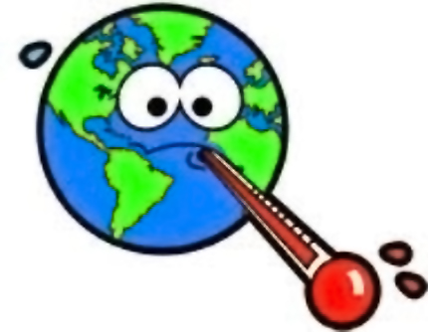
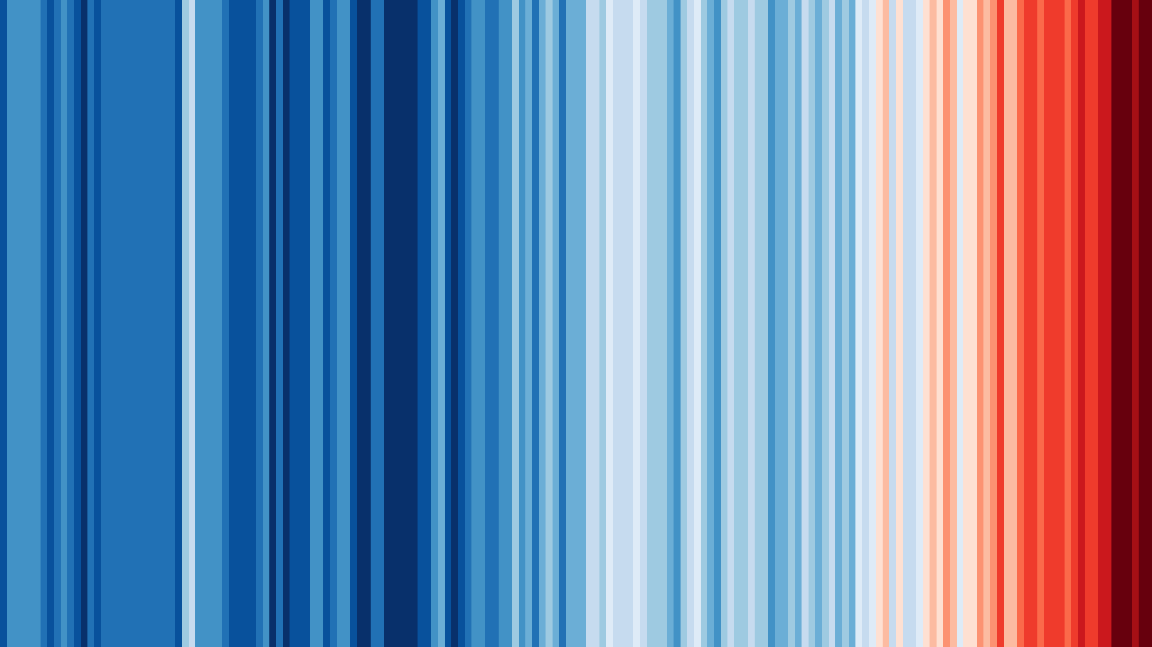
What temperature are the different continents of the world?
Learning objectives:
Name and locate the world’s seven continents (and five oceans)
Identify where hot and cold areas of the world are in relation to the Equator and the North and South Poles.
Consider how our local climate stripes compare to other countries.

Slide 2
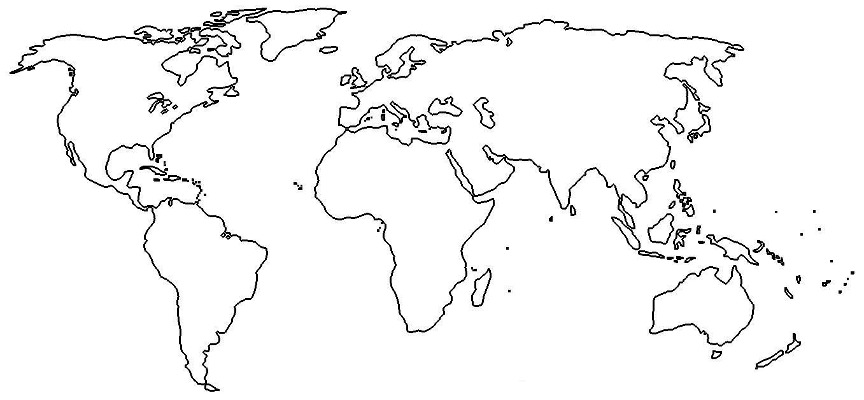
Map of the continents of the world
Notes:
Map adapted from https://worldmapwithcountries.net/2018/07/05/blank/ Ask children to name the continents?

Slide 3
Labelled map of the continents of the world
North
America
Europe
Asia
Africa
South
America
Oceania
Antarctica

Slide 4
Let’s look at what they look like in reality (from space):
https://earth.google.com/web/
Notes:
It is a good idea to pre-load Google Earth before the session as it takes a long time to load

Slide 5
The average temperatures of the continents (drag and drop the continents to the correct place):
Antarctica = - 49ºC
Africa = 22ºC
Hottest
continent
Coldest
continent
Asia = 16ºC
Oceania = 18ºC
North America = 15ºC
South America = 20ºC
Europe = 11ºC
Notes:
Drag continents next to the colours. These are colours the children are to colour the continents in.

Slide 6
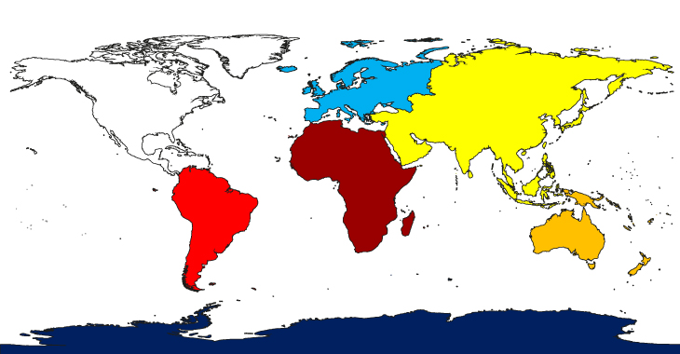
Answers
North
America
Europe
Asia
Africa
South
America
Oceania
Antarctica

Slide 7
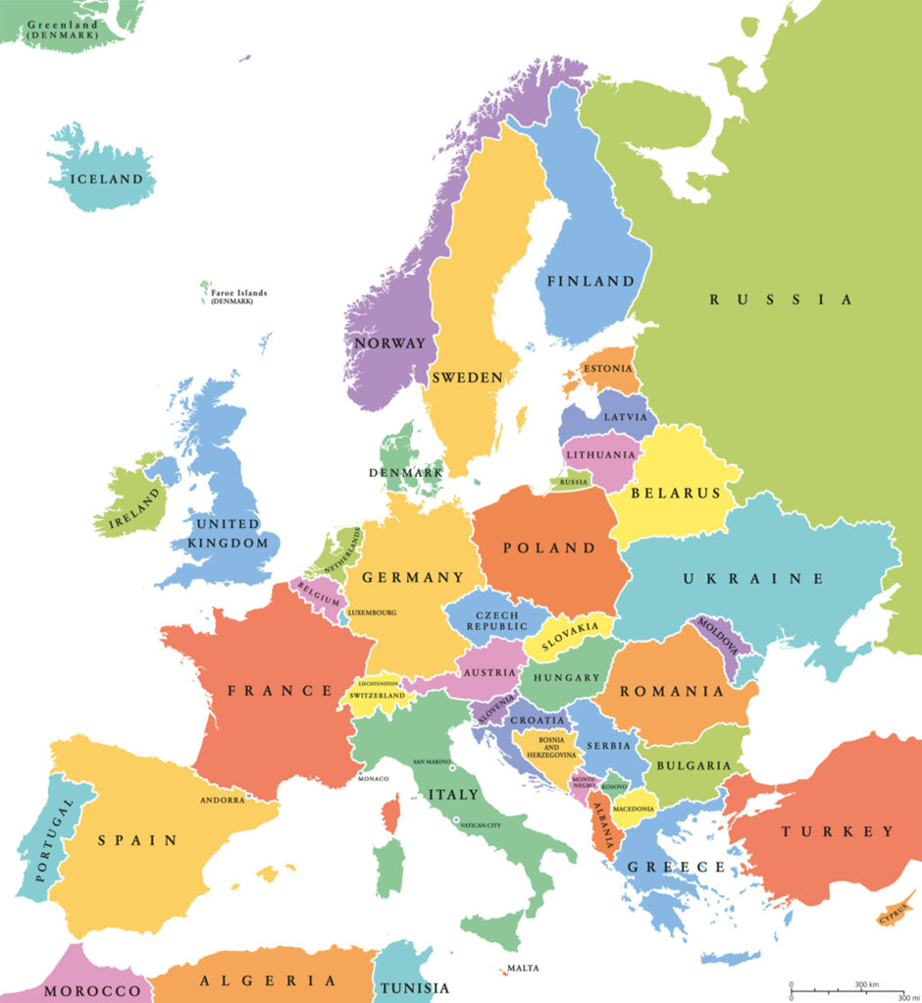
Continents are made of many countries. This is the continent of Europe. Can you find the country where we live?

Slide 8
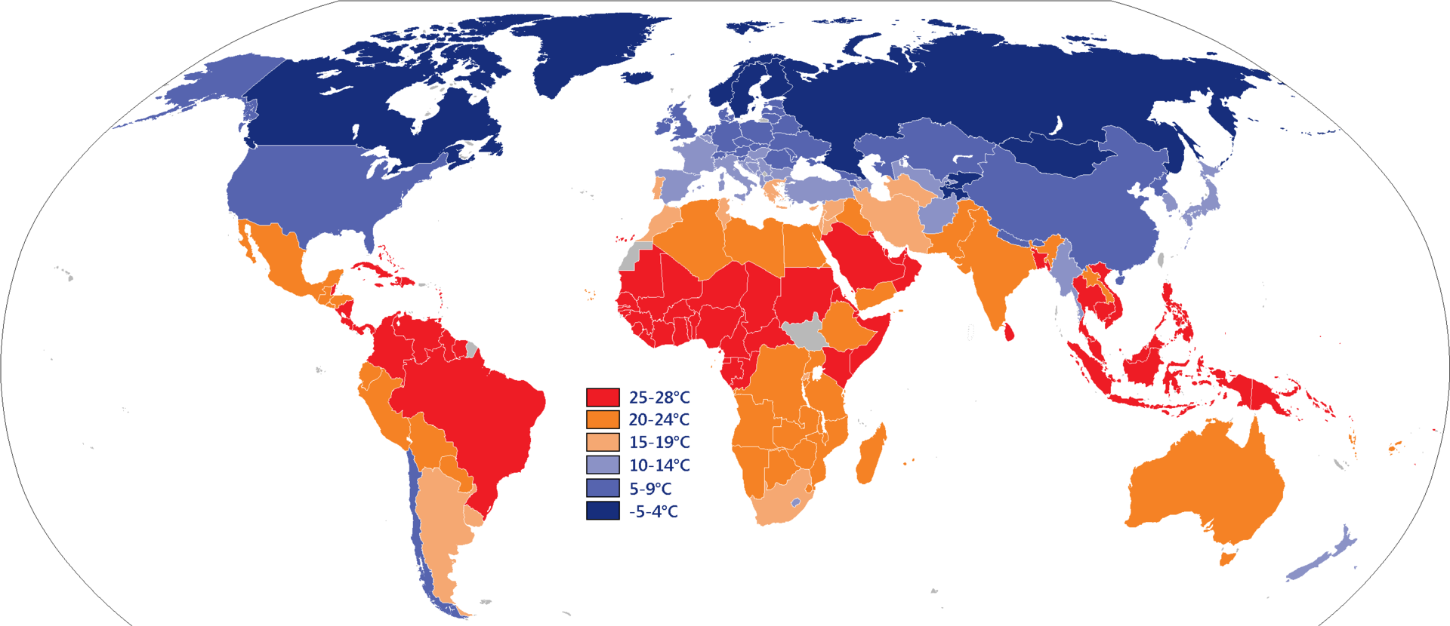
This is the average temperature of different countries in those continents. What do you notice?

Slide 9
Comparing Climate Stripes
Choose your local climate stripes from the #ShowYourStripes
website and add them here
Choose climate stripes from another location and add here to compare to your local stripes.

